Slide 1
ENTEVYUV 13.0
UMA MAHESWARI

Slide 2
PROJECT TITLE
Customer Lead Prediction

Slide 3
PROBLEM STATEMENT
The online Edu-Tech platform that generates leads through various sources.
The marketing and sales teams want to optimize their lead conversion rates and improve the efficiency of their lead management process.
The primary goal is to predict whether a lead will be successfully converted into a customer or not.
This prediction can help the Edu-Tech company to prioritize leads with the highest conversion potential and tailor marketing and sales strategies accordingly.
The analysis and prediction will be based on the information available in the provided dataset.

Slide 4
TOOLS USED
A machine-learning library for Python. It provides a selection of efficient tools for machine learning and statistical modeling including classification, regression, clustering and dimensionality reduction via a consistence interface in Python.
SEABORN
A data visualization library for Python. It is built on top of Matplotlib and provides a high-level interface for creating statistical graphs.
MATPLOTLIB
Extract Quantitive Inforamtion Plot a variety of graphs pyplot module Integrate with tools
PANDAS
Process Large Data sets Complex data analysis Data Frame objects Time series data.
NUMPY
Multi-Dimensinal array objects Data manipulation Scitific computations, statiscs foor Machine Learning Alogorithms.

Slide 5
APPROACHES
Get the DATA INFORMATION by using the Pandas Library.
Keep the required column for our analysis.
Handling the Missing Data values.
Visualize the Pre-processed data.
Finally apply the Machine Learning Algorithm

Slide 6
DATA VISUALIZATION

Slide 7
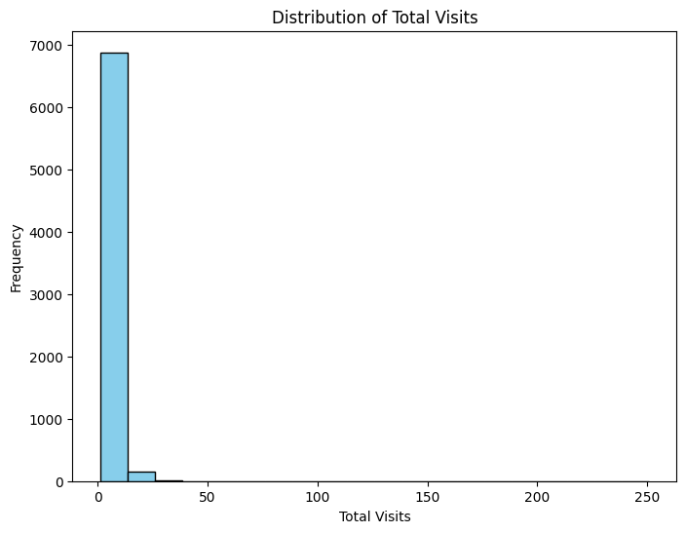
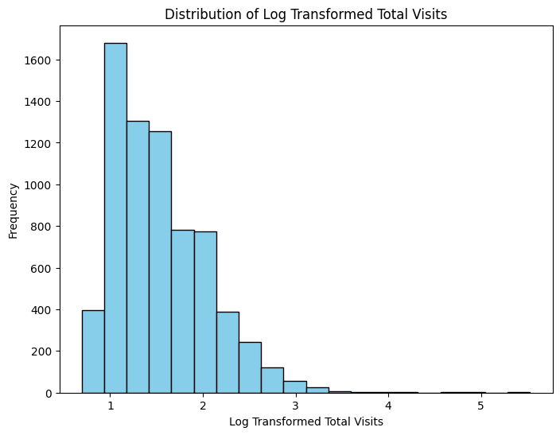
View distribution of total visit
Before Log Transform distribution is right sided skewed.
After Transformation it’s normally distributed.

Slide 8
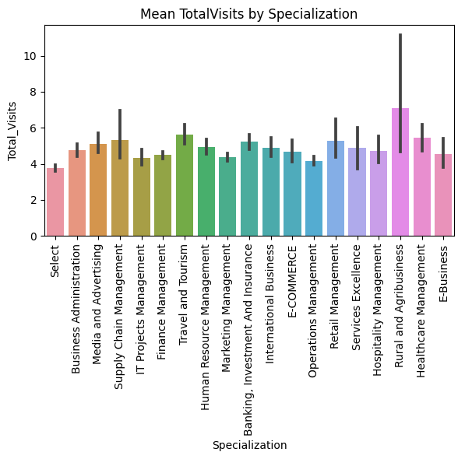
View of Total visits by specialization
The Rural and Agribusiness persons are visited the pages mostly.
Least visited specialization is E-Business.

Slide 9
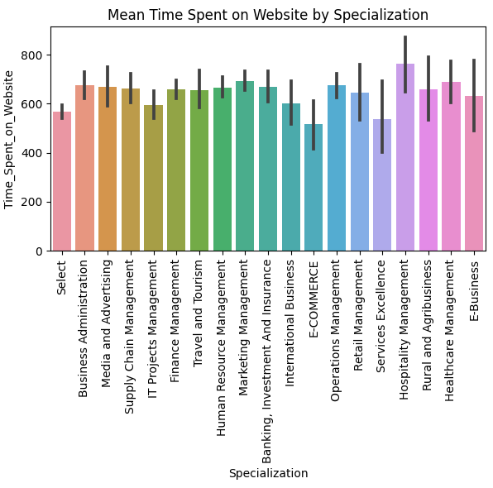
View of time spent on website by specialization
The Hospitality Management spend more time on the website and least spending time E-Commerce.

Slide 10
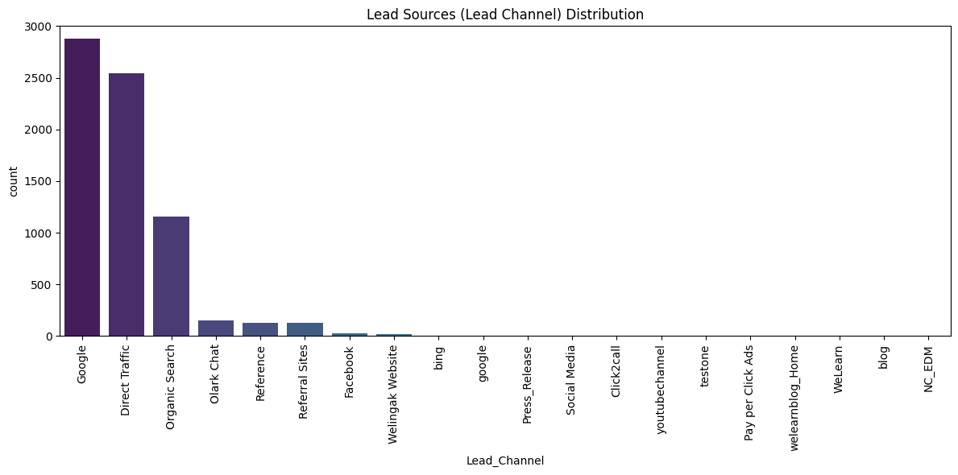
Distribution of lead source

Slide 11
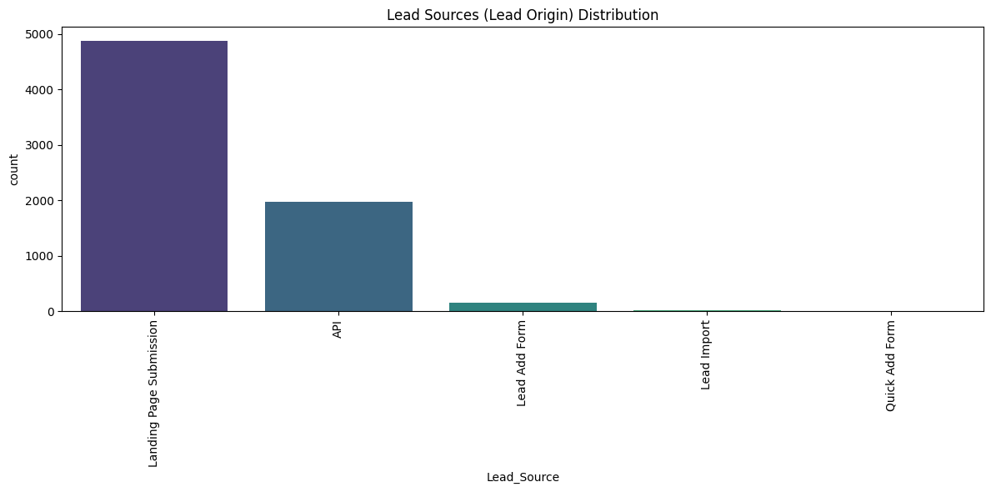
Distribution of lead origin

Slide 12
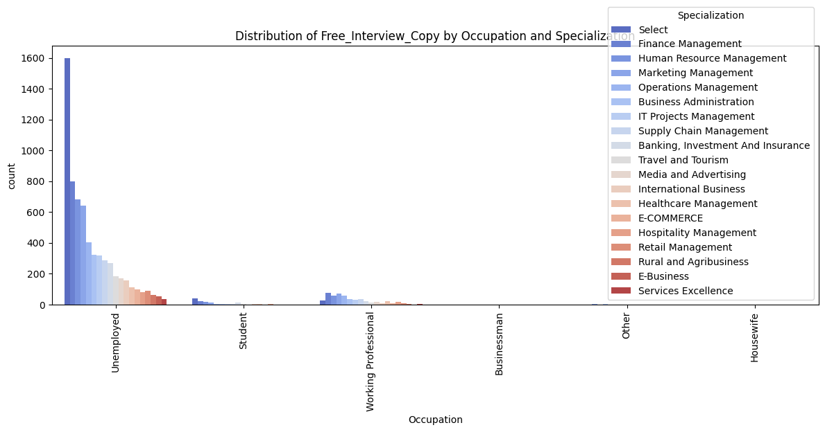
Free interview copy by specialization

Slide 13
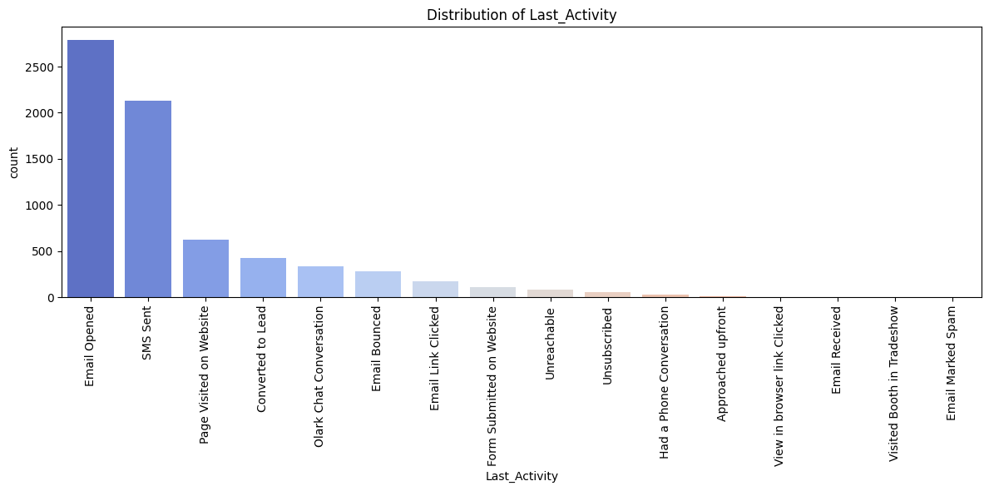
Last activity

Slide 14
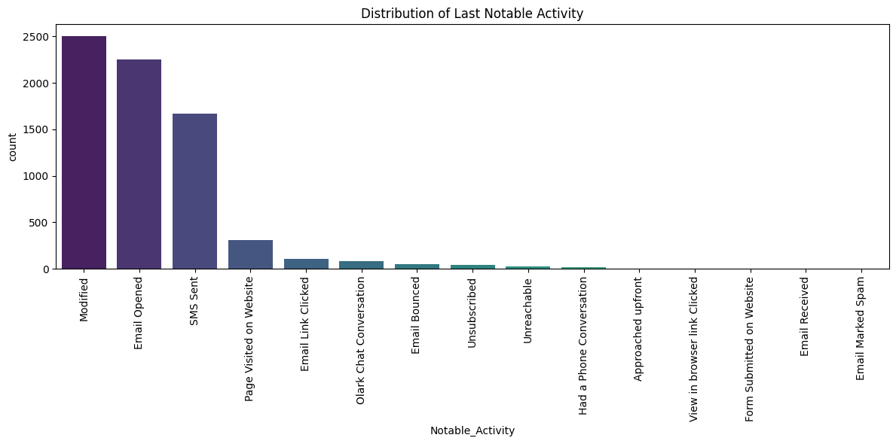
Last notable activity

Slide 15
Conclusion/suggestion
In summary, our project successfully used data analysis and machine learning to improve lead management and conversion rates. By prioritizing high-conversion leads and streamlining the process, we've made our marketing efforts more efficient. This data-driven approach holds the key to future success.

Slide 16


